Slide 1

Team 4
4
QUANTUM-AI TRAFFIC OPTIMIZATION

Slide 2
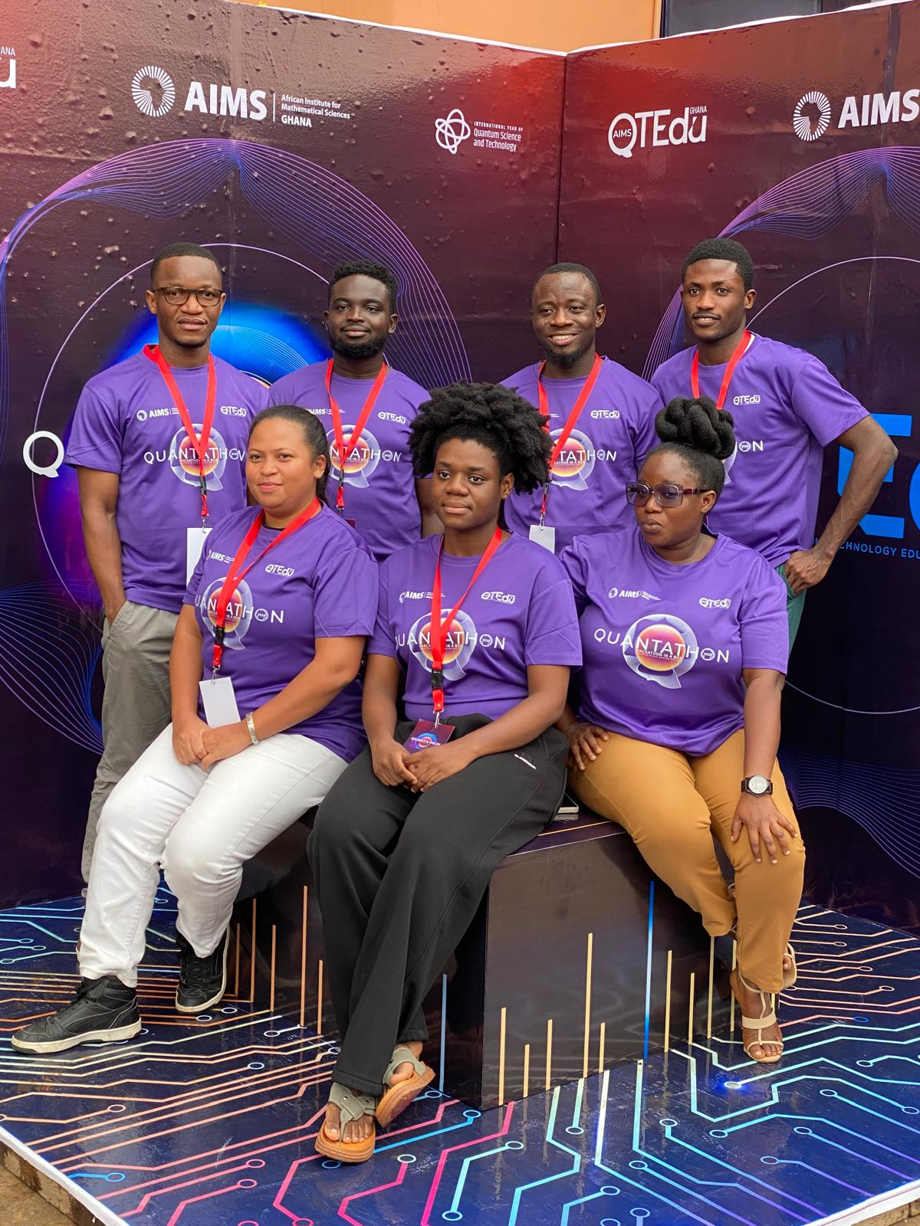

Slide 3
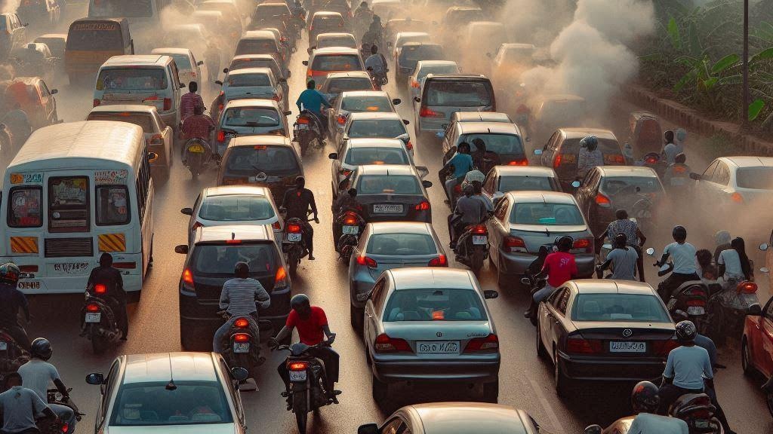
The Problem
In many African urban centers, persistent traffic congestion suppresses economic growth by wasting billions in lost work hours, consumed fuel, and postponed business dealings .An estimated amount of US $314 billion is lost in urban cities due to traffic congestion alone.
$314 billion annually

Slide 4
Country | Time Lost (Workdays/Year) | Economic Loss (Million USD/Day) | Notable Health/Social Impacts
🇬🇭 Ghana | 35 workdays/year | $1.1 million/day | High PM2.5 levels leads to increase in asthma cases, chest pain, headaches (Accra, Kumasi)
🇲🇬 Madagascar | 40 workdays/year (avg est.) | $0.11 million/day | Poor public transport; long delays; major highway upgrade ongoing
🇨🇲 Cameroon | 30–45 workdays/year (est. avg) | $9.9 million/day | Increase in road crashes (US $168M/year); severe congestion in Douala/Bamenda
🇳🇬 Nigeria | 70 workdays/year | $16.4 million/day | 11,000 pollution-related premature deaths/year (mostly in Lagos)
🇲🇦 Morocco | 25–30 workdays/year | 3.8 million/day (≈ 1.05% GDP / 365) | Cities like Casablanca exceed WHO air quality limits; households spending 10–20% of income on transport; traffic contributes ~⅓ of Morocco's CO₂ emissions

Slide 5
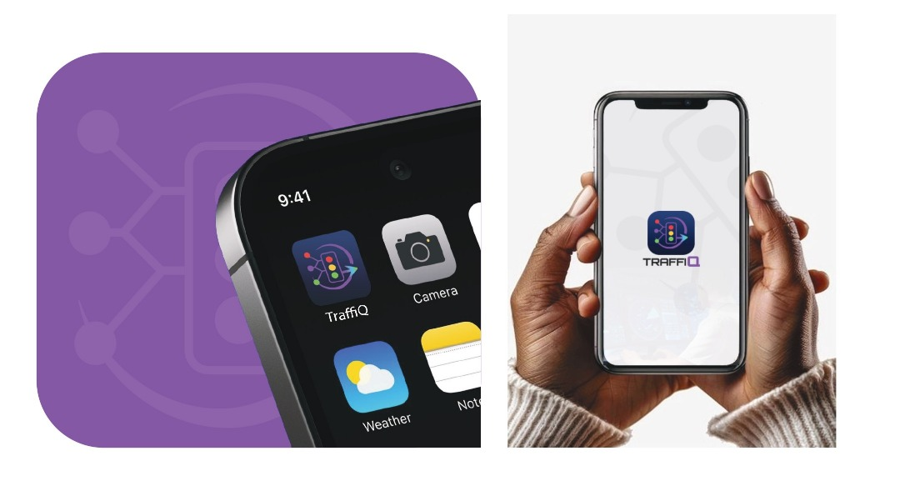
OUR SOLUTION
Real data adaptability
Congestion prediction using ML algorithm
Quantum optimization
USSD protocol for users/drivers

Slide 6
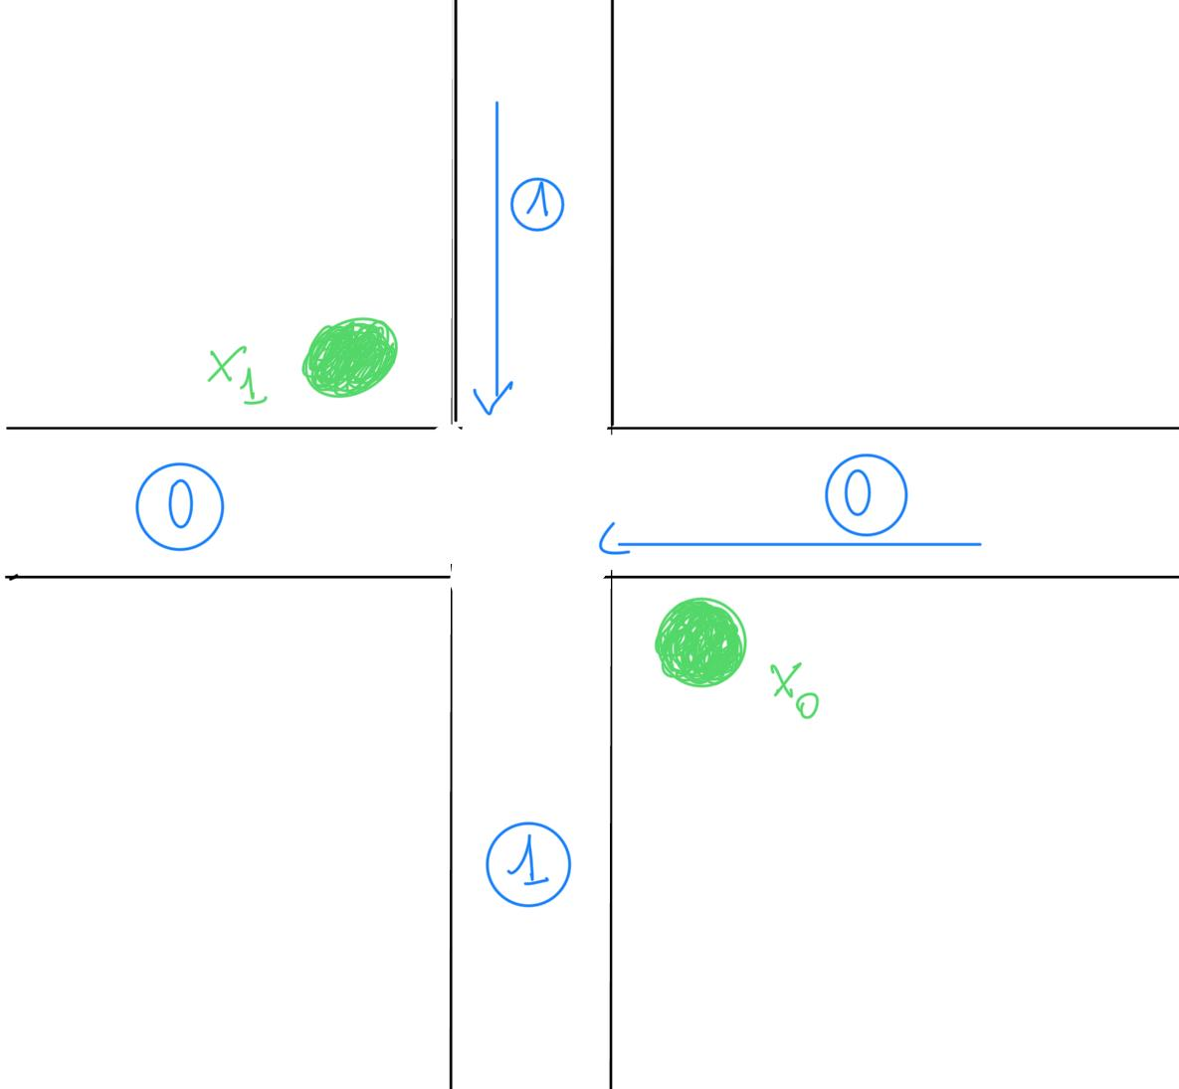
IMPLEMENTATION
Decision Variable
Objective Function
  x₀ ∈ ℤ: green time for main road m ≤ x₀ ≤ T − m
  x₁ ∈ ℤ: green time for side road m ≤ x₁ ≤ T − m
  Where m is minimal time for green light and T is total cycle time at the intersection.
  Minimize c₀·x₀ + c₁·x₁, where
  c₀ = 1 / (N₀ + ε), c₁ = 1 / (N₁ + ε)
  N₀ and N₁ are vehicle counts, ε is a small positive number.
QUBO Encoding:
  x₀ = Σ⁽ᵏ⁻¹⁾ 2ⁱ·b₀,ᵢ
  x₁ = Σ⁽ᵏ⁻¹⁾ 2ⁱ· b₁,ᵢ
  b₀,ᵢ and b₁,ᵢ ∈ {0,1} are binary variables
Constraint
  Penalty = λ · (Σ⁽ᵏ⁻¹⁾ 2ⁱ(b₀,ᵢ + b₁,ᵢ) − T)²
Objective Function
  Q = c₀·Σ⁽ᵏ⁻¹⁾ 2ⁱ·b₀,ᵢ + c₁·Σ⁽ᵏ⁻¹⁾ 2ⁱ·b₁,ᵢ + λ·(Σ⁽ᵏ⁻¹⁾ 2ⁱ(b₀,ᵢ + b₁,ᵢ) − T)²

Slide 7
APPROACH
Congestion Prediction
QAOA implementation
One Intersection
Two Intersections
QALG
Pygame
  Run Algorithm
  Retrieve result from database
  Store Results
  Simulations
Multiple Intersections
Qiskit
API

Slide 8
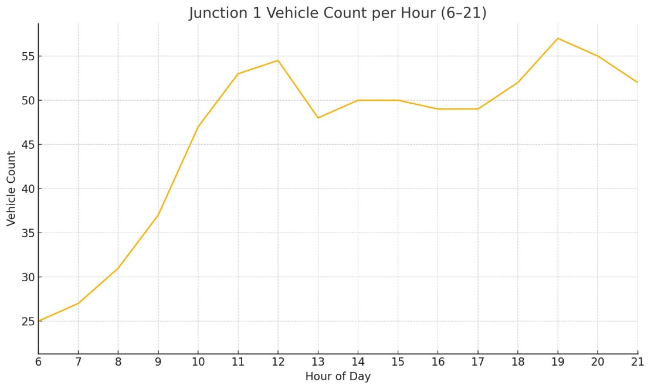
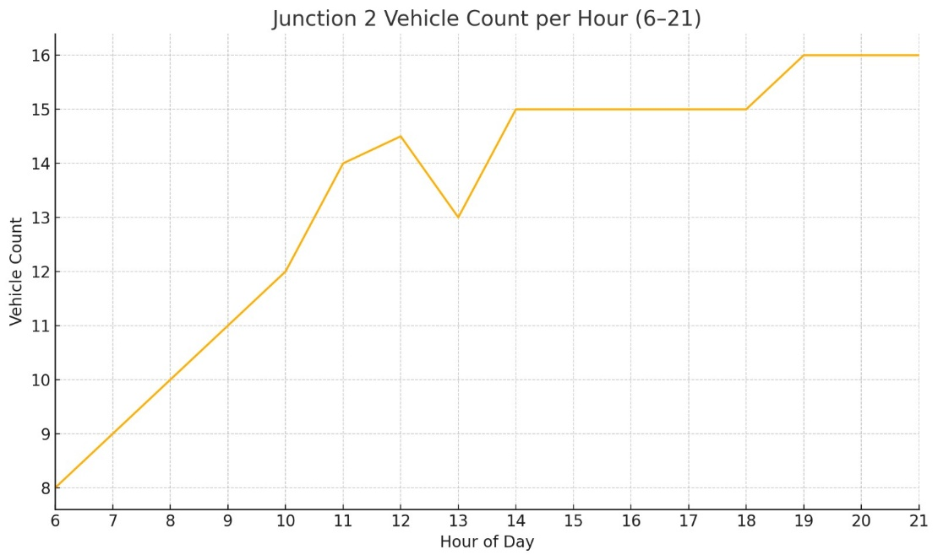
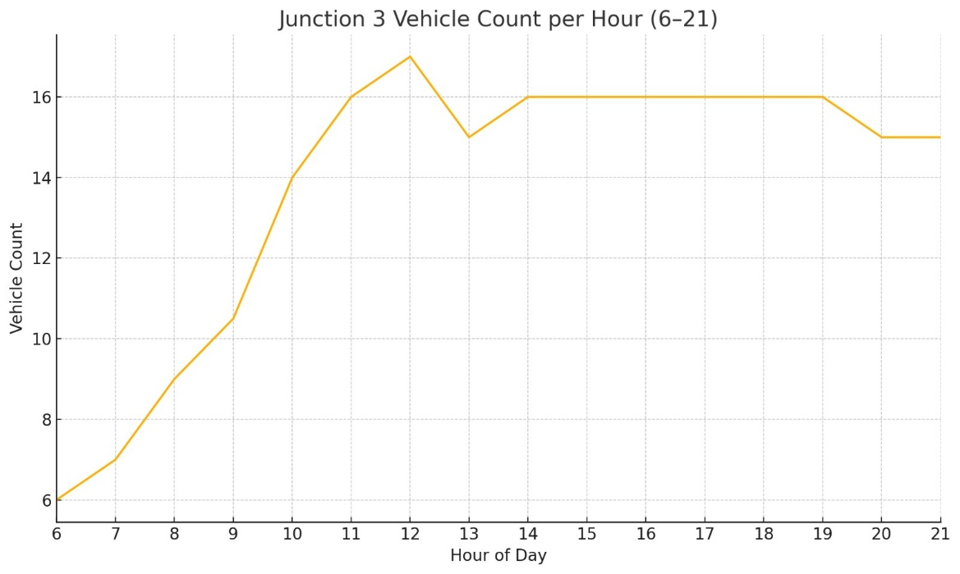
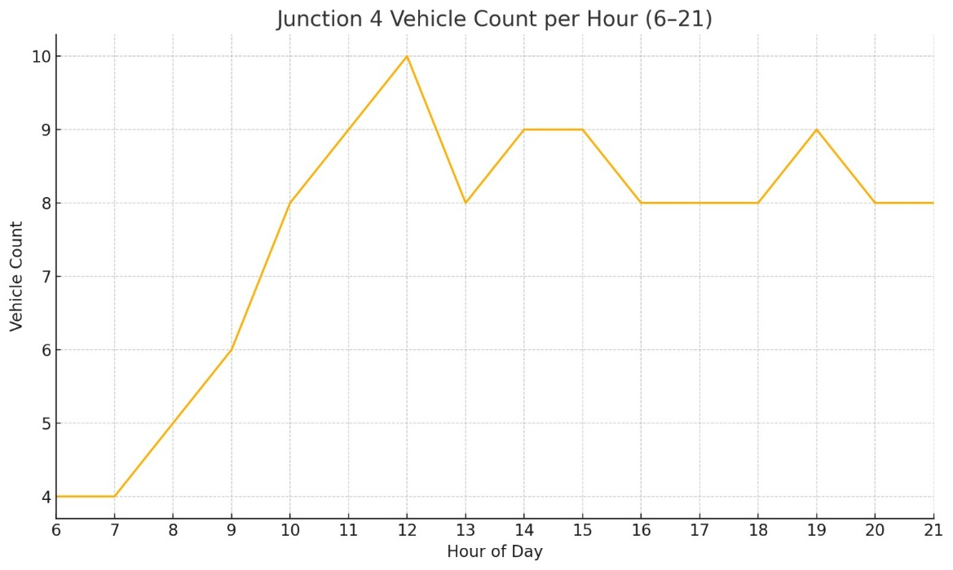

Slide 9
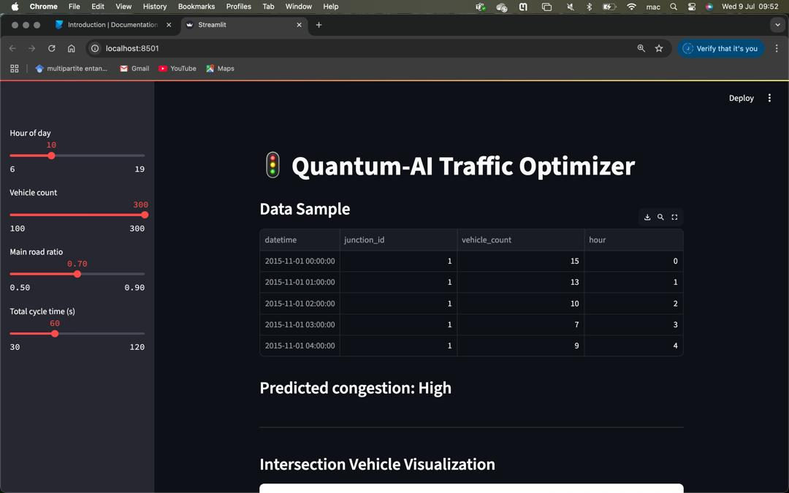
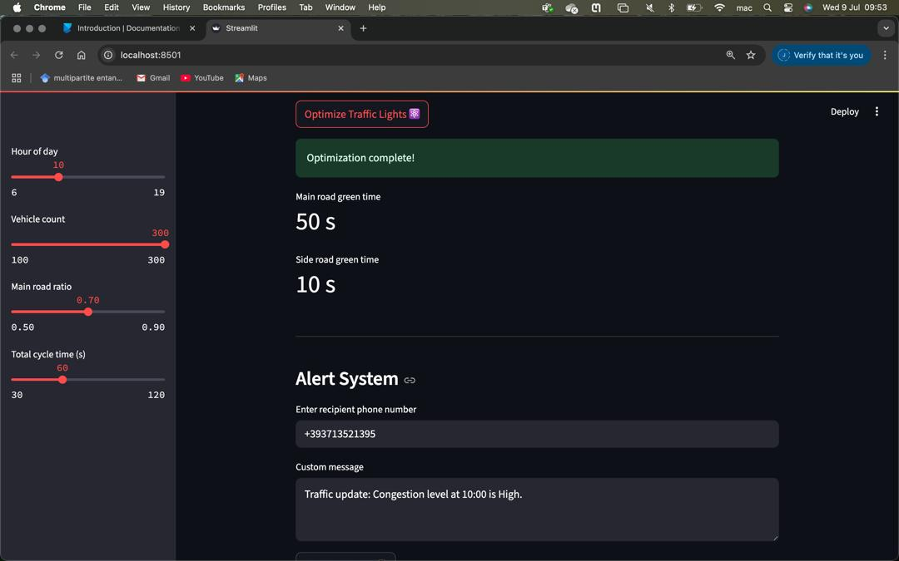
RESULTS

Slide 10
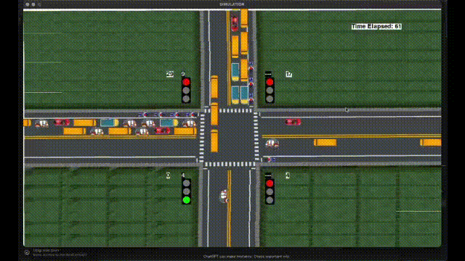
Traffic green light optimization simulation with pygame

Slide 11

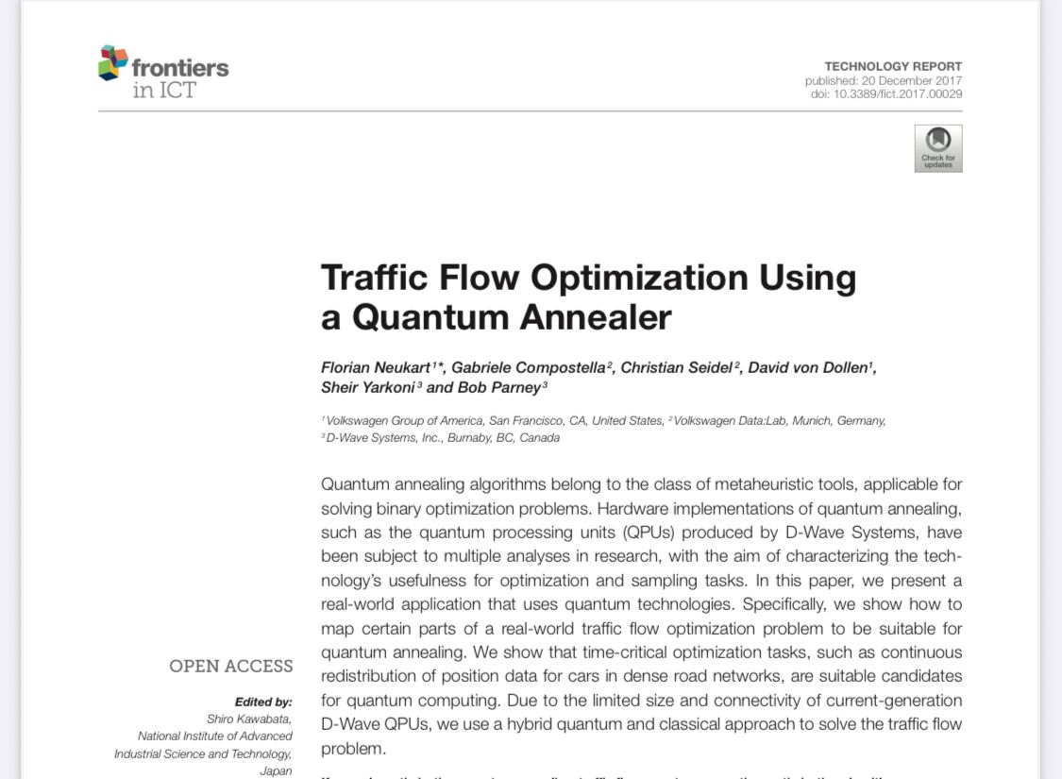
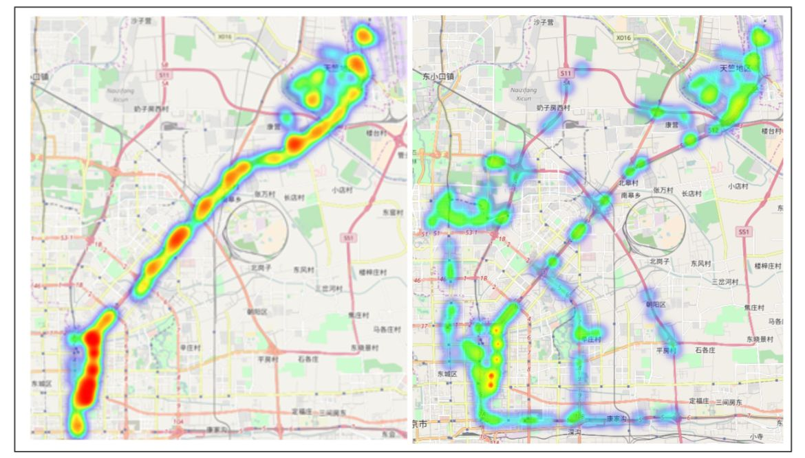
QUANTUM ADVANTAGE

Slide 12

BUSINESS PLAN
B2C (Business-to-Consumer)
Target: Individual drivers, commuters, logistics companies
Value Proposition: Get real-time traffic insights (via USSD/app)
Reduce travel time and fuel costs
Avoid fines or delays from congestion
Useful for ride-hailing, delivery, private car owners
Revenue Models: Freemium app (basic vs premium insights)
Daily/weekly subscription via mobile money
Ad-supported (location-based promotions)
Sell premium access to driver unions (e.g., taxi associations)
B2G (Business-to-Government)
Target: Municipalities, Transport Ministries, Smart City programs
Value Proposition: Optimize traffic light timing using real-time data
Reduce congestion and emissions across key intersections
Improve emergency response times
Feed into urban planning, public safety, and infrastructure investment
Revenue Models: Licensing fees for traffic management system
Public-private partnerships (PPP)
Data-as-a-service (provide analytics dashboards and traffic reports)Implementation contracts (paid consultancy + platform deployment)

Slide 13






Slide 14

IMPACT
Optimizing green light reduces traffic, making road safer, cities better, the air cleaner, people healthier and more productive.

Slide 15
4
MEDAASE
MERCI
THANK YOU!

