Slide 1
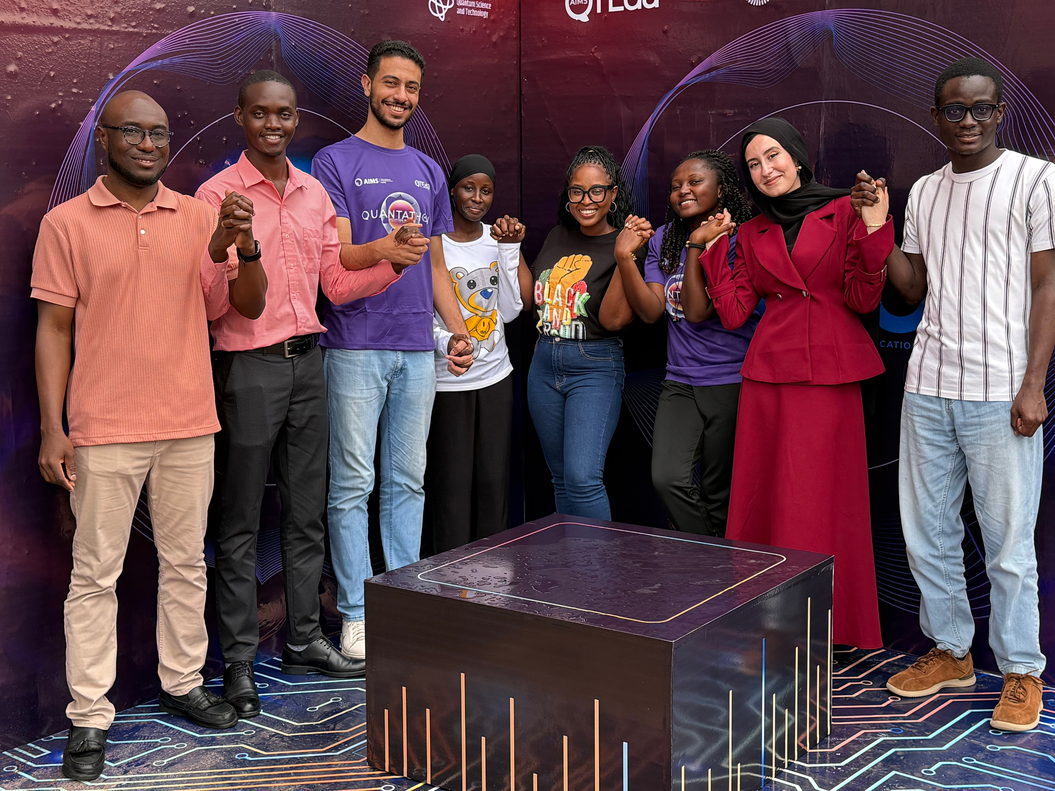

Q
Team 3

Slide 2





Q
“Lighting Up Africa with Smarter Grids and Quantum Power”
Team 3

Slide 3
8%
of the World’s Population do not have access to Electicity
https://unsdg.un.org/latest/stories/decoding-africa%E2%80%99s-energy

Slide 4

80%
Are in Africa!
https://unsdg.un.org/latest/stories/decoding-africa%E2%80%99s-energy

Slide 5

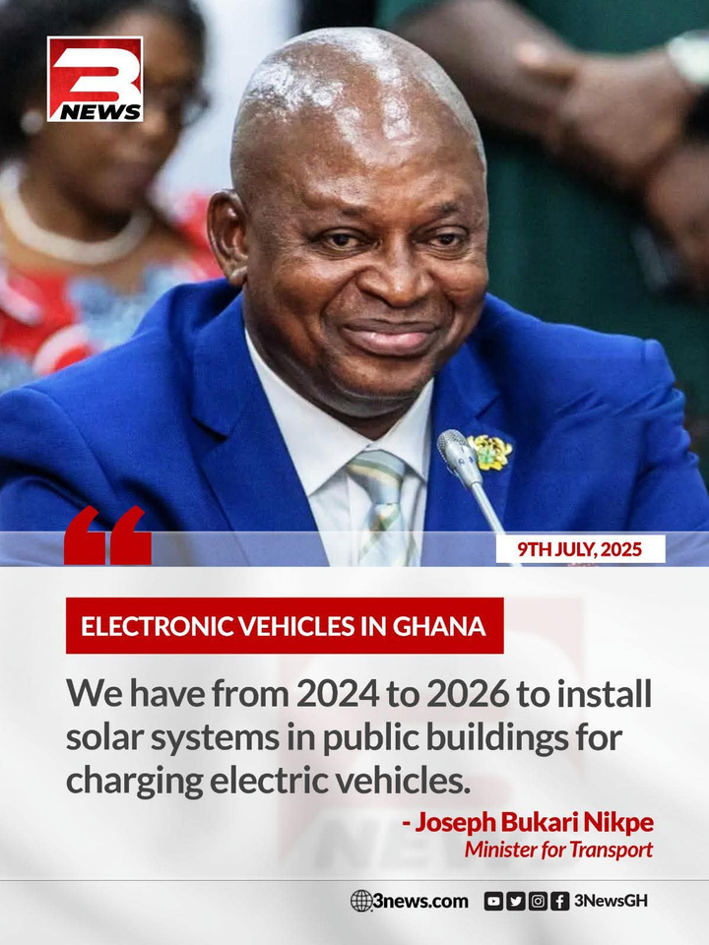
Over 600 Million people in Sub-Saharan Africa live without Access to electricity!
More than Half of the Region’s Population!

Slide 6


PROBLEM STATEMENT
Determining the optimal placement of microgrids to maximize energy delivery while minimizing installation costs and ensuring electricity access to underserved communities is
a Complex Combinatorial Challenge.

Slide 7
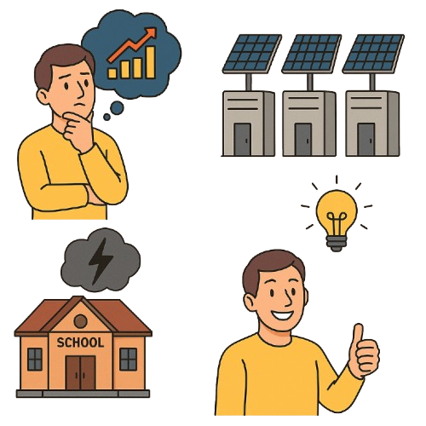


PROBLEM
EXPENSIVE
$2 Million
No Electricity
Minimise the cost of installation
Maximise Energy production
Maximise Population Coverage
Optimised Grid Installation

Slide 8
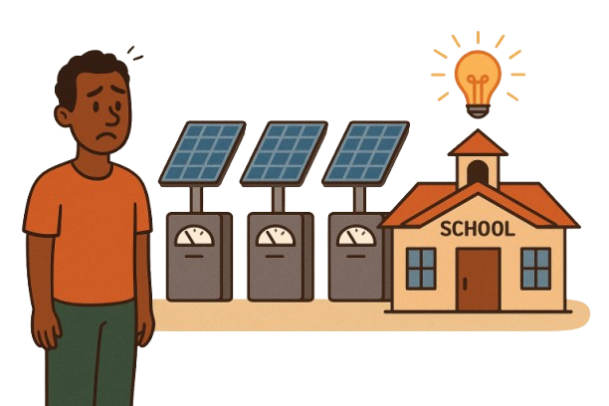


HOW WE SOLVE IT?
Happy Client
Optimised Grid Installation
More Energy , Less Cost

Slide 9

Target SDGs

Slide 10
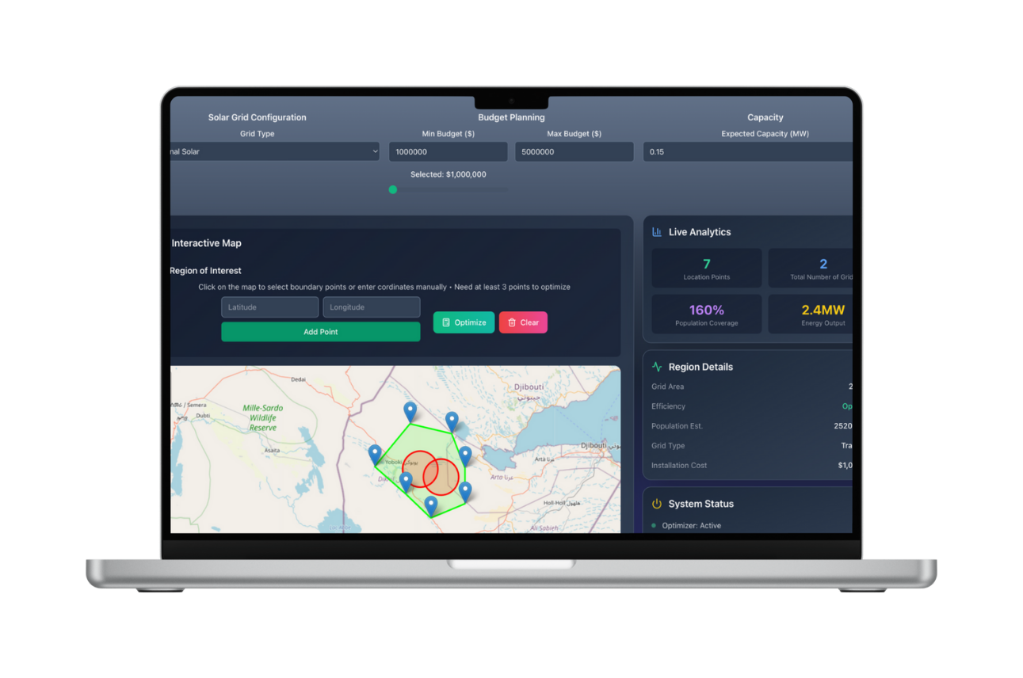
Q
A smart, quantum-powered software platform that optimizes the placement of off-grid microgrids across rural Africa using Quantum Optimisation

Slide 11
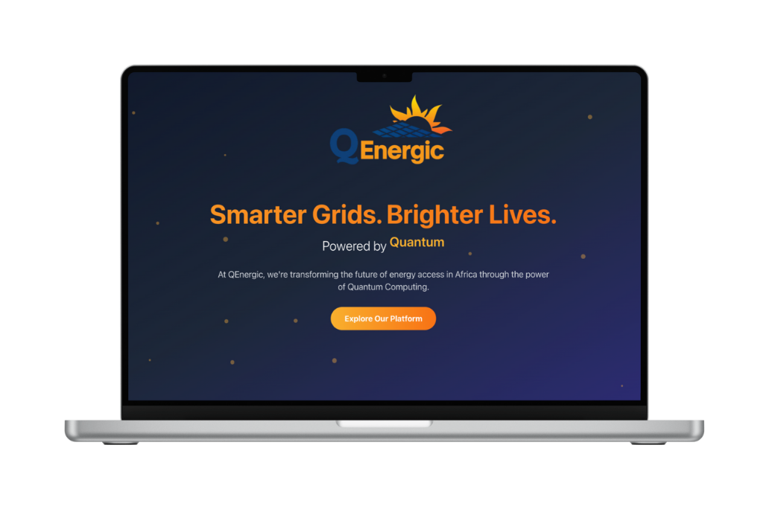

Our Solution Features
Find the most cost-effective microgrid placements under real-world constraints
Instantly estimates energy output, cost, and people reached, helping stakeholders evaluate and compare electrification strategies
Visualizes population coverage, and installation cost to support smart, location-aware decision-making

Slide 12
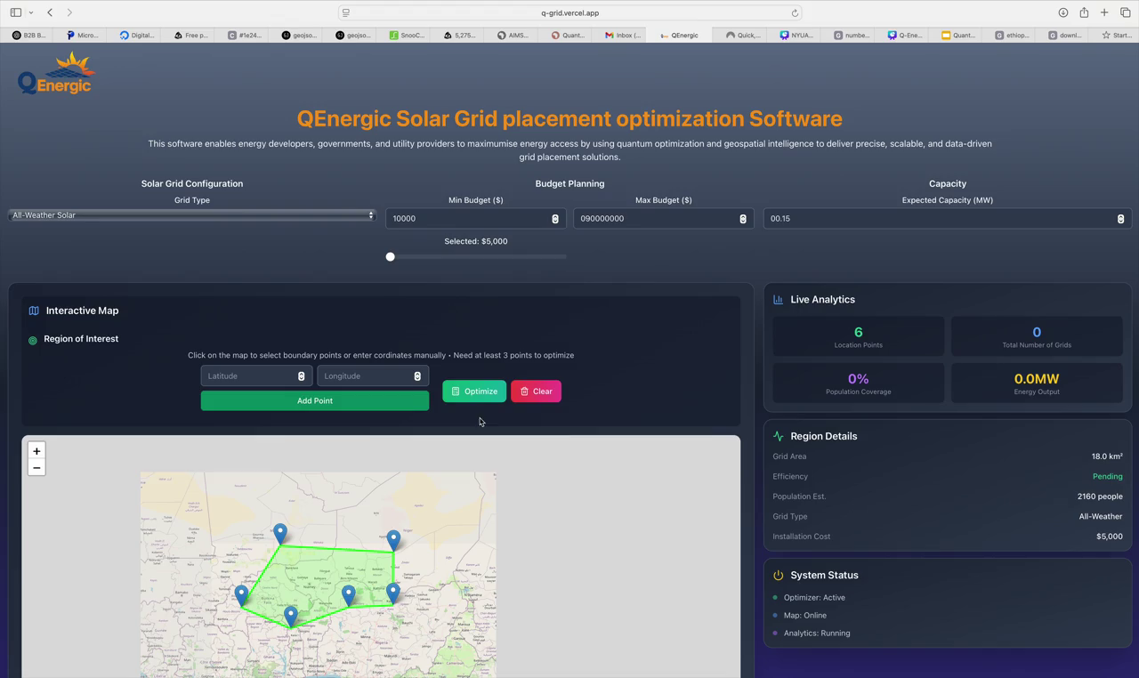
Our Solution

Slide 13



Technical Solution
COSTS (OBJECTIVES)
Minimize the total cost of installing microgrids
Maximizing the population served with electricity
CONSTRAINTS
  Budget Constraint
  Energy Demand Constraint

Slide 14


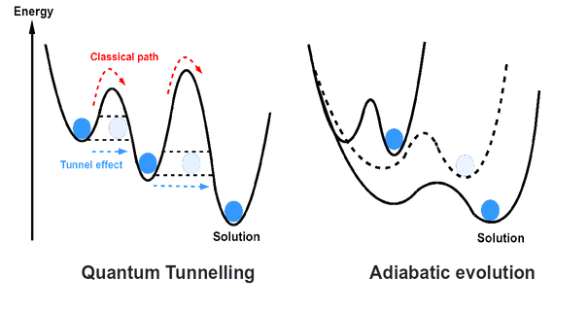
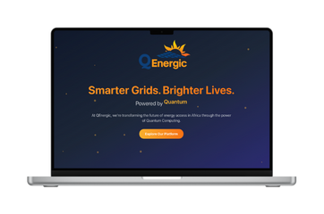
System Architecture
Mathematical Modelling of the QUBO
Quantum Solver
Results
Max Energy
Grid installation
Data Instance
Dwave-Qbsolv
Max Coverage
Number of Grids
AutoQUBO Framework
Location
Max Budget
Needed Energy
Coverage
QUBO Matrix
Hybrid-Solver

Slide 15
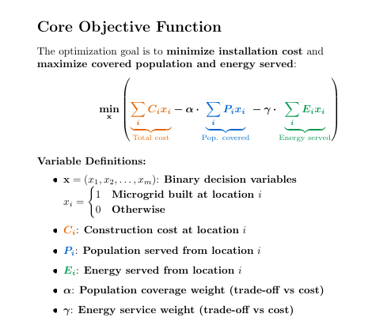
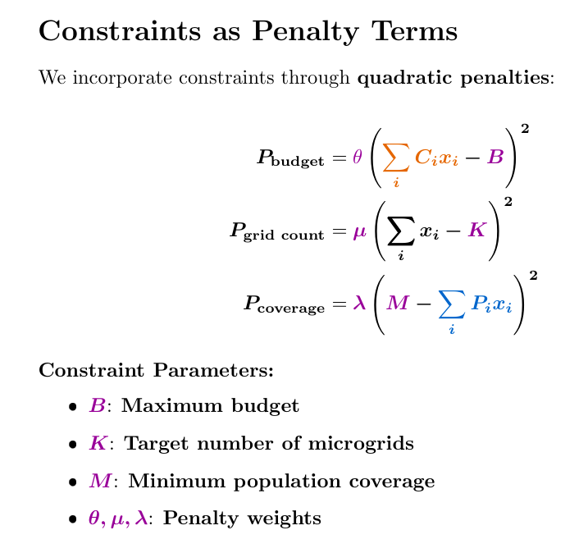
Mathematical QUBO modelling

Slide 16
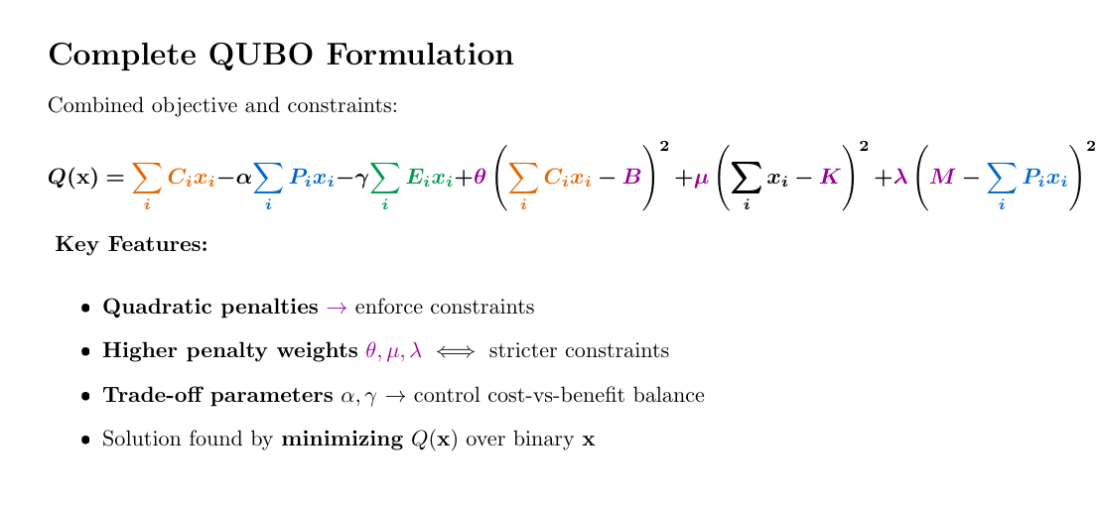
Mathematical QUBO modelling

Slide 17
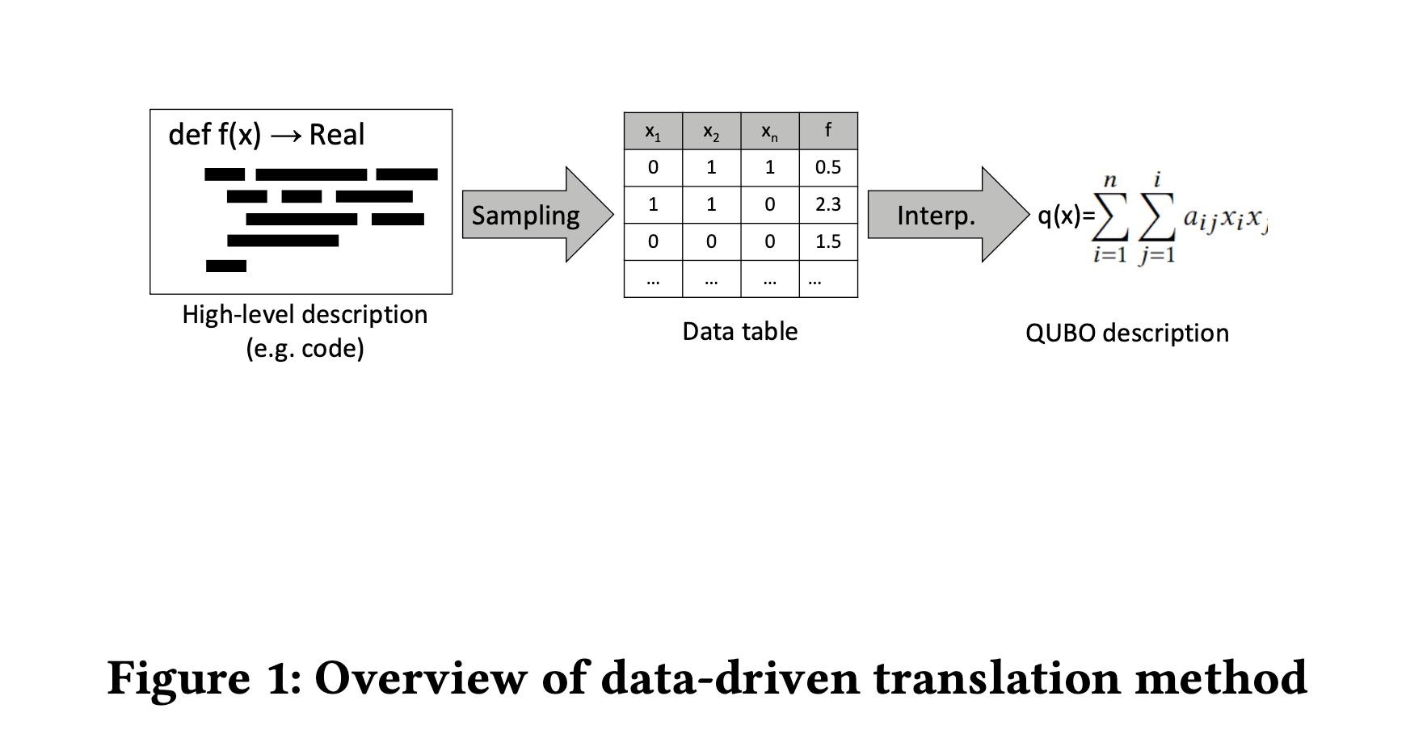
AutoQUBO Framework

Slide 18


DataSet: Off-grid microgrid deployement in Ethiopia
Randomly generated dataset with 50 candidate sites
Data Instance (Features)
Number of Grids: 10
Location: Ethiopia
Max Budget: 900,0000
Coverage: 15,000
  Installation cost (USD Dollar)
  Population coverage
  Solar potential (Kwh_m2/day )
  Energy capacity (Kwh/day)
  Spatial coordinates

Slide 19
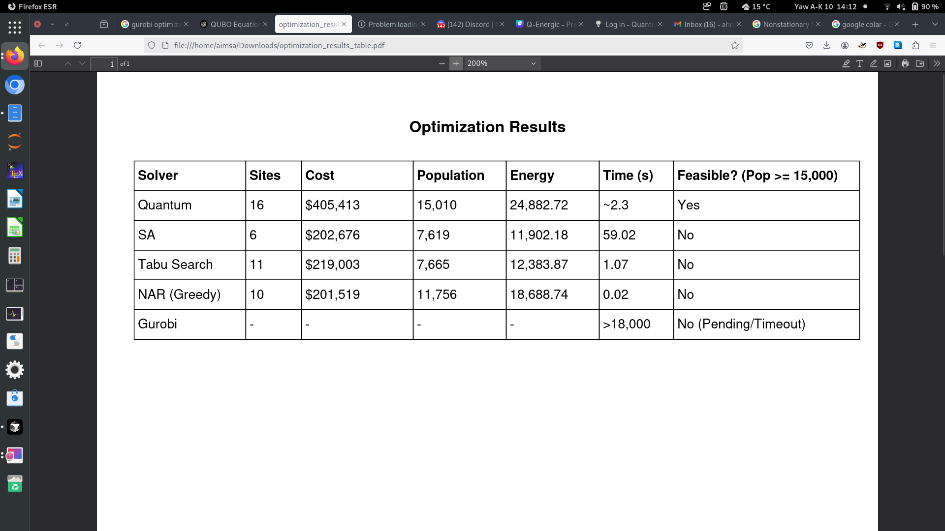
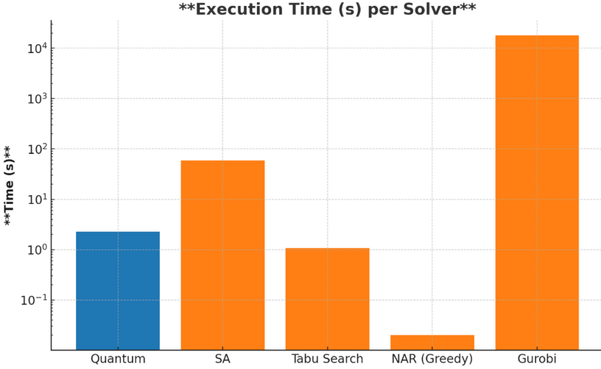
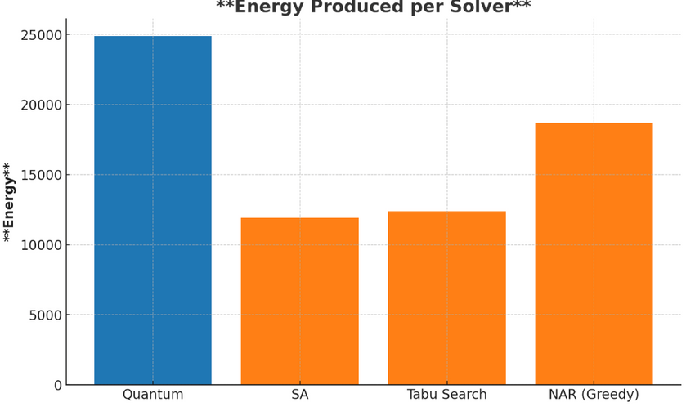


RESULTS & DISCUSSION

Slide 20
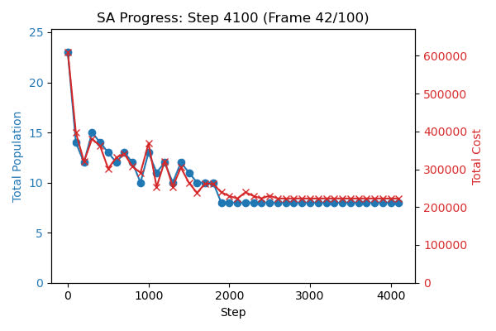
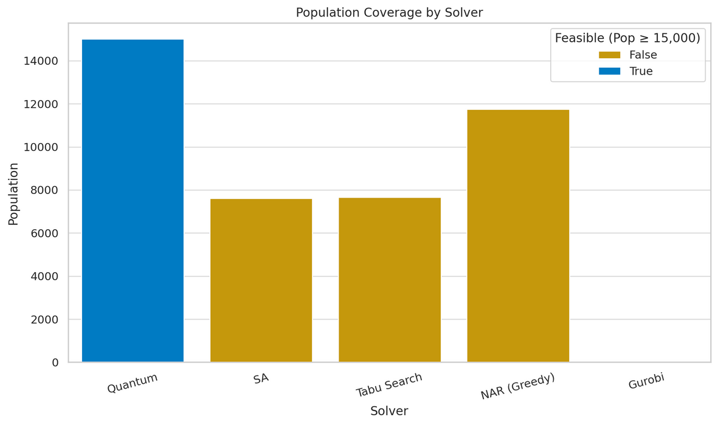
RESULTS & DISCUSSION

Slide 21



TECH STACK
Front-End
Back-End
Quantum Solution

Slide 22
BUSINESS PLAN
MARKET AND OPPORTUNITIES
B2B
B2G
Value Proposition
Features
Features
  Infrastructure planning
  Resource allocation
  Faster feasibility and strategic planning
  QUBO-based optimisation software
  API interfaces
  Budget and resource constraint modelling
  QUBO-based optimisation software
  API interfaces
  Budget and resource constraint modelling
Revenue Stream
  SaaS subscriptions and Licensing fees
  Grants
for microgrid operators and asset owners
for governments and NGOs

Slide 23



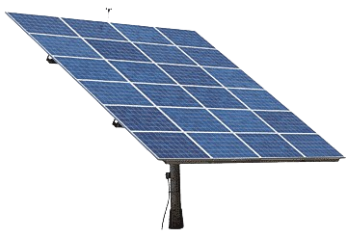
MARKET AND OPPORTUNITIES
Market Potential
Comparative Analysis
Global Market
Optimization
Method
Quantum Optimisation
Rule based GIS
USD 236.18 billion
Classical Simiulation
Engineering Base
Target
Users
Africa
scalable
Nigeria
Partial
Tanzania
Kenya
Africa focus
African Market
Constraint
Flexibility
89%
USD 4.3 billion
Scenario
Similation
$10,000 to $50,000 depending on Capacity
https://www.precedenceresearch.com/microgrid-market

Slide 24




OUR IMPACT
Business Sustainability & Scalability
Expands electricity access in remote and underserved communities
Reduces dependence on fossil fuels and cuts carbon emissions
Lowers infrastructure costs while maximizing return on investment
Supports strategic, data-driven decision-making for policymakers and developers

Slide 25
FUTURE PLAN
3 months
6 months
1 Year
Use infinityQ for a better optimization
Monitoring grid health
and usage
Build or employ quantum sensor to optimize grid placement

Slide 26
Q
Join Us in the journey of Driving Economic Impact and improving lives by making Electricity accessible to all !
Team 3

